Slide 1
Carparking Application

Slide 2
Team - B
TEAM MEMBERS
Aditya Purohit (Code)
Ayush Atte
Aman Singh Patel (Documentation) - Lead
Annanya Rajpal

Slide 3
Problem Statement
Carparking Application is to provide show all the nearby parking spots according to nearest location and help the users to find a parking spot.

Slide 4
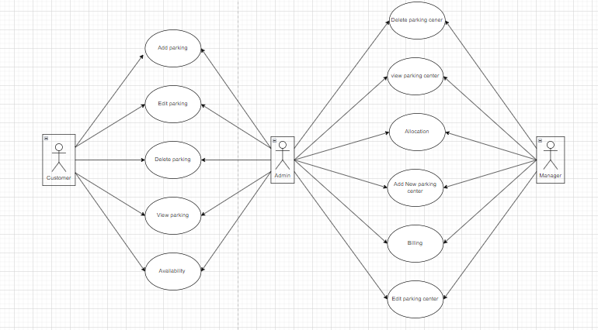
Use Case Diagram

Slide 5
Technology Used
JAVA 11
MYSQL - DataBase
Swagger - Documenting The APIs
Eclipse – Most Used Java IDE
Spring Boot – Java based Dependency Injection Framework

Slide 6
Features
Admin can Add/Edit/Delete/View parking details.
Manager can search for new parking for lease, parking allocation, Parking availability service .
Customer can search service, have a preference to search for near by parking and Parking booking service/billing .

Slide 7
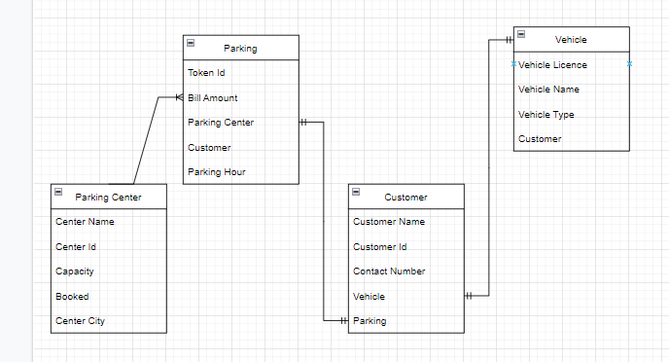
Entity Relationship Diagram

Slide 8
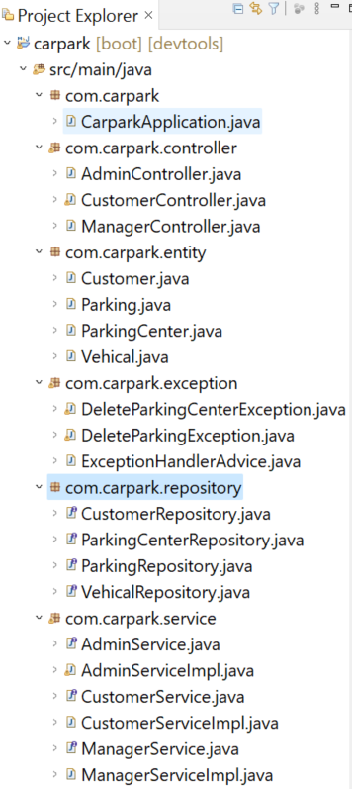
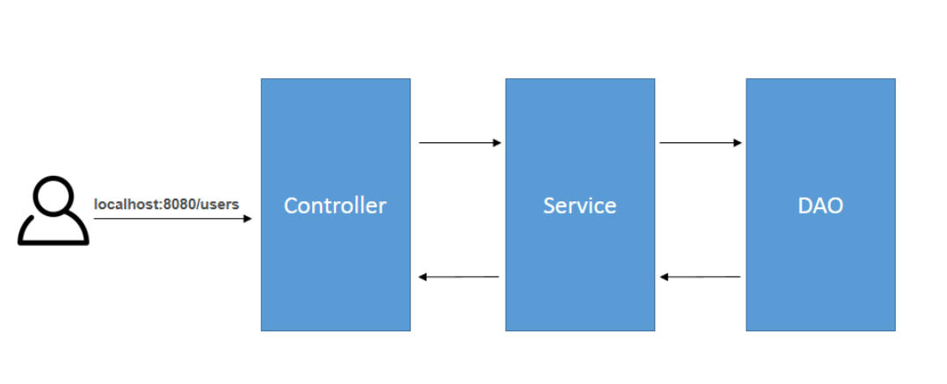
Project Structure

Slide 9
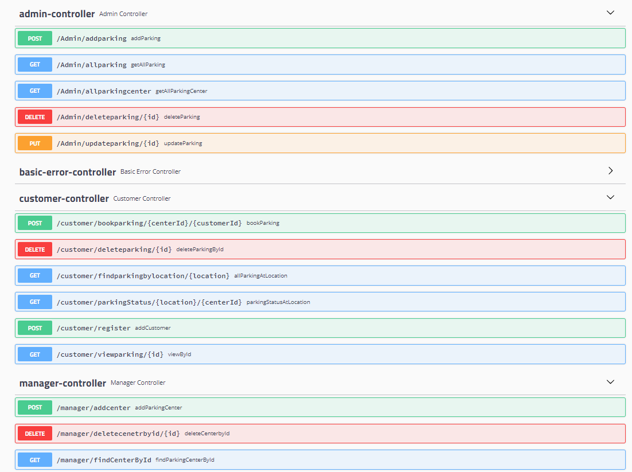
Rest API end points

Slide 10

Questions Any ?

Slide 11
Thank you

